Slide 1

Hi-Landers Ham Class
Instructed by Rich Bugarin W6EC

Slide 2
Sub-element 9 of 10

Slide 3
Ham Radio Technician Class Exam preparation Power Point created by Rich Bugarin W6EC.
Effective July 1, 2022 and is valid until June 30, 2026.
Please send suggested changes to this presentation to:
w6ec@thebugarins.com

Slide 4
Study Hints
I suggest you read each question and only the correct answer. Read through the complete question pool at least three times before you attempt taking a practice exams. For higher impact and better results read the correct answer first then the question and again the correct answer.
The key to passing the exam is to get the most questions correct using the above method the correct response will often jump out at you on test day even if you don’t remember the question.

Slide 5
Text Color
Black: Original/Official questions and information in original format (unaltered).
Red: Original information text color simply changed to highlight subject.
Blue: Notes and information added by Rich (W6EC).

Slide 6
SUBELEMENT T9 – ANTENNAS AND FEED LINES
[2 Exam Questions - 2 Groups]

Slide 7
T9A – Antennas: vertical and horizontal polarization, concept of antenna gain, definition and types of beam antennas, antenna loading, common portable and mobile antennas, relationships between resonant length and frequency, dipole pattern
#31 of 35
Math formula to calculate Wavelength (λ)
λ = 300 ÷ Frequency (in Mega Hertz)

Slide 8
T9A01
What is a beam antenna?
A. An antenna built from aluminum I-beams
B. An omnidirectional antenna invented by Clarence Beam
C. An antenna that concentrates signals in one direction
D. An antenna that reverses the phase of received signals

Slide 9
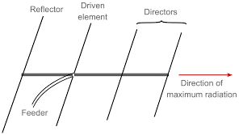
T9A01
What is a beam antenna?
A. An antenna built from aluminum I-beams
B. An omnidirectional antenna invented by Clarence Beam
C. An antenna that concentrates signals in one direction
D. An antenna that reverses the phase of received signals

Slide 10
T9A02
Which of the following describes a type of antenna loading?
A. Electrically lengthening by inserting inductors in radiating elements
B. Inserting a resistor in the radiating portion of the antenna to make it resonant
C. Installing a spring in the base of a mobile vertical antenna to make it more flexible
D. Strengthening the radiating elements of a beam antenna to better resist wind damage

Slide 11
T9A02
Which of the following describes a type of antenna loading?
A. Electrically lengthening by inserting inductors in radiating elements
B. Inserting a resistor in the radiating portion of the antenna to make it resonant
C. Installing a spring in the base of a mobile vertical antenna to make it more flexible
D. Strengthening the radiating elements of a beam antenna to better resist wind damage

Slide 12
T9A03
Which of the following describes a simple dipole oriented parallel to Earth's surface?
A. A ground-wave antenna
B. A horizontally polarized antenna
C. A travelling-wave antenna
D. A vertically polarized antenna

Slide 13
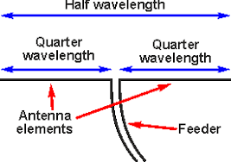
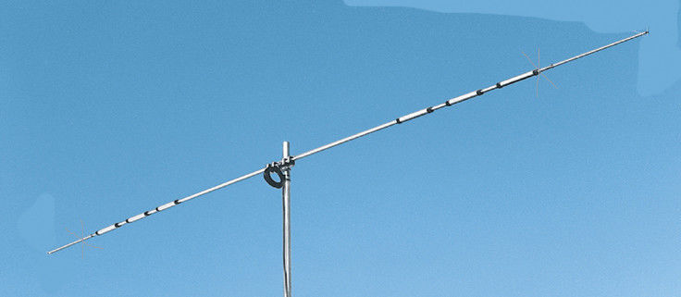
T9A03
Which of the following describes a simple dipole oriented parallel to Earth's surface?
A. A ground-wave antenna
B. A horizontally polarized antenna
C. A travelling-wave antenna
D. A vertically polarized antenna

Slide 14
T9A04
What is a disadvantage of the short, flexible antenna supplied with most handheld radio transceivers, compared to a full-sized quarter-wave antenna?
A. It has low efficiency
B. It transmits only circularly polarized signals
C. It is mechanically fragile
D. All these choices are correct

Slide 15
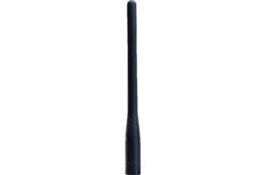
T9A04
What is a disadvantage of the short, flexible antenna supplied with most handheld radio transceivers, compared to a full-sized quarter-wave antenna?
A. It has low efficiency
B. It transmits only circularly polarized signals
C. It is mechanically fragile
D. All these choices are correct

Slide 16
T9A05
Which of the following increases the resonant frequency of a dipole antenna?
A. Lengthening it
B. Inserting coils in series with radiating wires
C. Shortening it
D. Adding capacitive loading to the ends of the radiating wires

Slide 17
T9A05
Which of the following increases the resonant frequency of a dipole antenna?
A. Lengthening it
B. Inserting coils in series with radiating wires
C. Shortening it (Remember John Trovita)
D. Adding capacitive loading to the ends of the radiating wires

Slide 18
T9A06
Which of the following types of antenna offers the greatest gain?
A. 5/8 wave vertical
B. Isotropic
C. J pole
D. Yagi

Slide 19
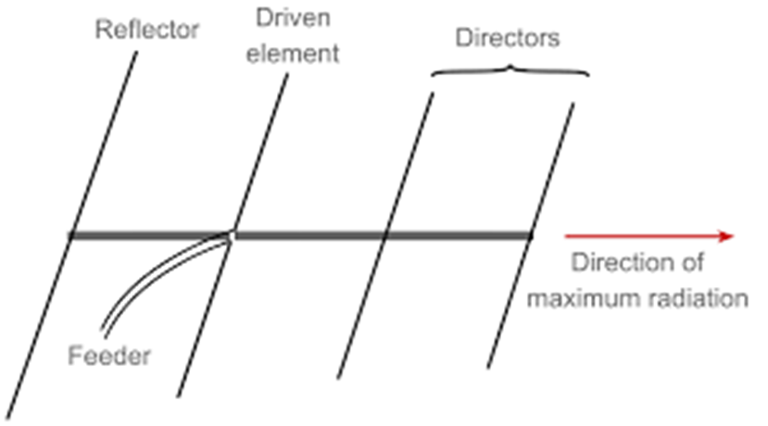
T9A06
Which of the following types of antenna offers the greatest gain?
A. 5/8 wave vertical
B. Isotropic
C. J pole
D. Yagi

Slide 20
T9A07
What is a disadvantage of using a handheld VHF transceiver with a flexible antenna inside a vehicle?
A. Signal strength is reduced due to the shielding effect of the vehicle
B. The bandwidth of the antenna will decrease, increasing SWR
C. The SWR might decrease, decreasing the signal strength
D. All these choices are correct

Slide 21
T9A07
What is a disadvantage of using a handheld VHF transceiver with a flexible antenna inside a vehicle?
A. Signal strength is reduced due to the shielding effect of the vehicle
B. The bandwidth of the antenna will decrease, increasing SWR
C. The SWR might decrease, decreasing the signal strength
D. All these choices are correct

Slide 22
T9A08
What is the approximate length, in inches, of a quarter-wavelength vertical antenna for 146 MHz?
A. 112
B. 50
C. 19
D. 12

Slide 23
T9A08
What is the approximate length, in inches, of a quarter-wavelength vertical antenna for 146 MHz?
A. 112
B. 50
C. 19
D. 12
Math
300 ÷ 146 = 2.05479
¼ wave = ÷ by 4
2.05479 ÷ 4 = 0.51369 (Meters)
Convert meters to inches by multiplying by 39
0.51369 x 39 = 20.03
19 inches is the closest answer
(Just memorize 19)

Slide 24
T9A09
What is the approximate length, in inches, of a half-wavelength 6 meter dipole antenna?
A. 6
B. 50
C. 112
D. 236

Slide 25
T9A09
What is the approximate length, in inches, of a half-wavelength 6 meter dipole antenna?
A. 6
B. 50
C. 112
D. 236
Math
½ wave = ÷ by 2
6 ÷ 2 = 3 (Meters)
Convert meters to inches by multiplying by 39
3 x 39 = 117
112 inches is the closest answer
(Just memorize 112)

Slide 26
T9A10
In which direction does a half-wave dipole antenna radiate the strongest signal?
A. Equally in all directions
B. Off the ends of the antenna
C. In the direction of the feed line
D. Broadside to the antenna

Slide 27

T9A10
In which direction does a half-wave dipole antenna radiate the strongest signal?
A. Equally in all directions
B. Off the ends of the antenna
C. In the direction of the feed line
D. Broadside to the antenna

Slide 28
T9A11
What is antenna gain?
A. The additional power that is added to the transmitter power
B. The additional power that is required in the antenna when transmitting on a higher frequency
C. The increase in signal strength in a specified direction compared to a reference antenna
D. The increase in impedance on receive or transmit compared to a reference antenna

Slide 29
T9A11
What is antenna gain?
A. The additional power that is added to the transmitter power
B. The additional power that is required in the antenna when transmitting on a higher frequency
C. The increase in signal strength in a specified direction compared to a reference antenna
D. The increase in impedance on receive or transmit compared to a reference antenna

Slide 30
T9A12
What is an advantage of a 5/8 wavelength whip antenna for VHF or UHF mobile service?
A. It has more gain than a 1/4-wavelength antenna
B. It radiates at a very high angle
C. It eliminates distortion caused by reflected signals
D. It has 10 times the power gain of a 1/4 wavelength whip

Slide 31
T9A12
What is an advantage of a 5/8 wavelength whip antenna for VHF or UHF mobile service?
A. It has more gain than a 1/4-wavelength antenna
B. It radiates at a very high angle
C. It eliminates distortion caused by reflected signals
D. It has 10 times the power gain of a 1/4 wavelength whip

Slide 32
T9B – Feed lines: types, attenuation vs frequency, selecting; SWR concepts; Antenna tuners (couplers); RF Connectors: selecting, weather protection
#32 of 35

Slide 33
T9B01
What is a benefit of low SWR?
A. Reduced television interference
B. Reduced signal loss
C. Less antenna wear
D. All these choices are correct

Slide 34
T9B01
What is a benefit of low SWR?
A. Reduced television interference
B. Reduced signal loss
C. Less antenna wear
D. All these choices are correct

Slide 35
T9B02
What is the most common impedance of coaxial cables used in amateur radio?
A. 8 ohms
B. 50 ohms
C. 600 ohms
D. 12 ohms

Slide 36
T9B02
What is the most common impedance of coaxial cables used in amateur radio?
A. 8 ohms
B. 50 ohms
C. 600 ohms
D. 12 ohms

Slide 37
T9B03
Why is coaxial cable the most common feed line for amateur radio antenna systems?
A. It is easy to use and requires few special installation considerations
B. It has less loss than any other type of feed line
C. It can handle more power than any other type of feed line
D. It is less expensive than any other type of feed line

Slide 38
T9B03
Why is coaxial cable the most common feed line for amateur radio antenna systems?
A. It is easy to use and requires few special installation considerations
B. It has less loss than any other type of feed line
C. It can handle more power than any other type of feed line
D. It is less expensive than any other type of feed line

Slide 39
T9B04
What is the major function of an antenna tuner (antenna coupler)?
A. It matches the antenna system impedance to the transceiver's output impedance
B. It helps a receiver automatically tune in weak stations
C. It allows an antenna to be used on both transmit and receive
D. It automatically selects the proper antenna for the frequency band being used

Slide 40
T9B04
What is the major function of an antenna tuner (antenna coupler)?
A. It matches the antenna system impedance to the transceiver's output impedance
B. It helps a receiver automatically tune in weak stations
C. It allows an antenna to be used on both transmit and receive
D. It automatically selects the proper antenna for the frequency band being used

Slide 41
T9B05
What happens as the frequency of a signal in coaxial cable is increased?
A. The characteristic impedance decreases
B. The loss decreases
C. The characteristic impedance increases
D. The loss increases

Slide 42
T9B05
What happens as the frequency of a signal in coaxial cable is increased?
A. The characteristic impedance decreases
B. The loss decreases
C. The characteristic impedance increases
D. The loss increases

Slide 43
T9B06
Which of the following RF connector types is most suitable for frequencies above 400 MHz?
A. UHF (PL-259/SO-239)
B. Type N
C. RS-213
D. DB-25

Slide 44

T9B06
Which of the following RF connector types is most suitable for frequencies above 400 MHz?
A. UHF (PL-259/SO-239)
B. Type N
C. RS-213
D. DB-25

Slide 45
T9B07
Which of the following is true of PL-259 type coax connectors?
A. They are preferred for microwave operation
B. They are watertight
C. They are commonly used at HF and VHF frequencies
D. They are a bayonet-type connector

Slide 46


T9B07
Which of the following is true of PL-259 type coax connectors?
A. They are preferred for microwave operation
B. They are watertight
C. They are commonly used at HF and VHF frequencies
D. They are a bayonet-type connector

Slide 47
T9B08
Which of the following is a source of loss in coaxial feed line?
A. Water intrusion into coaxial connectors
B. High SWR
C. Multiple connectors in the line
D. All these choices are correct

Slide 48
T9B08
Which of the following is a source of loss in coaxial feed line?
A. Water intrusion into coaxial connectors
B. High SWR
C. Multiple connectors in the line
D. All these choices are correct

Slide 49
T9B09
What can cause erratic changes in SWR?
A. Local thunderstorm
B. Loose connection in the antenna or feed line
C. Over-modulation
D. Overload from a strong local station

Slide 50
T9B09
What can cause erratic changes in SWR?
A. Local thunderstorm
B. Loose connection in the antenna or feed line
C. Over-modulation
D. Overload from a strong local station

Slide 51
T9B10
What is the electrical difference between RG-58 and RG-213 coaxial cable?
A. There is no significant difference between the two types
B. RG-58 cable has two shields
C. RG-213 cable has less loss at a given frequency
D. RG-58 cable can handle higher power levels

Slide 52
T9B10
What is the electrical difference between RG-58 and RG-213 coaxial cable?
A. There is no significant difference between the two types
B. RG-58 cable has two shields
C. RG-213 cable has less loss at a given frequency
D. RG-58 cable can handle higher power levels

Slide 53
T9B11
Which of the following types of feed line has the lowest loss at VHF and UHF?
A. 50-ohm flexible coax
B. Multi-conductor unbalanced cable
C. Air-insulated hardline
D. 75-ohm flexible coax

Slide 54
T9B11
Which of the following types of feed line has the lowest loss at VHF and UHF?
A. 50-ohm flexible coax
B. Multi-conductor unbalanced cable
C. Air-insulated hardline
D. 75-ohm flexible coax

Slide 55
T9B12
What is standing wave ratio (SWR)?
A. A measure of how well a load is matched to a transmission line
B. The ratio of amplifier power output to input
C. The transmitter efficiency ratio
D. An indication of the quality of your station’s ground connection

Slide 56
T9B12
What is standing wave ratio (SWR)?
A. A measure of how well a load is matched to a transmission line
B. The ratio of amplifier power output to input
C. The transmitter efficiency ratio
D. An indication of the quality of your station’s ground connection

Slide 57
End of Sub-element 9
(91% completed)
Proceed to Sub-element 10 when ready

